Slide 1
ITMD 421 – Data Modeling and Applications
Aastha Gupta
Lecture 4
September 18, 2017

Slide 2
Objectives
Relational Model
Concepts
Components
Implementation

Slide 3
Logical View
Relational database model is a logical representation of the data and its relationships
It is important for an efficient database design

Slide 4
Characteristics
A table is composed of rows and columns.
Each row represents a single occurrence within an entity.
Column represents attributes.
Each column has a distinct name.
Interaction of row and columns represents data value.
All values of the column should be confined to the same data format

Slide 5
Keys
Consist of one or more attributes that determine other attributes
Used to:
Ensure that each row in a table is uniquely identifiable
Establish relationships among tables and to ensure the integrity of the data
Primary key (PK): Attribute or combination of attributes that uniquely identifies any given row

Slide 6
Dependencies
Functional dependence: Value of one or more attributes determines the value of one or more other attributes
Determinant: Attribute whose value determines another
Dependent: Attribute whose value is determined by the other attribute
Full functional dependence: Entire collection of attributes in the determinant is necessary for the relationship

Slide 7
Types of Keys
Composite key: Key that is composed of more than one attribute
Key attribute: Attribute that is a part of a key
Entity integrity: Condition in which each row in the table has its own unique identity
All of the values in the primary key must be unique
No key attribute in the primary key can contain a null

Slide 8
Types of Keys
Null: Absence of any data value that could represent:
An unknown attribute value
A known, but missing, attribute value
A inapplicable condition
Referential integrity: Every reference to an entity instance by another entity instance is valid

Slide 9
Relational Database Keys
Super Key
Candidate Key
Primary Key
Foreign Key
Composite Key

Slide 10
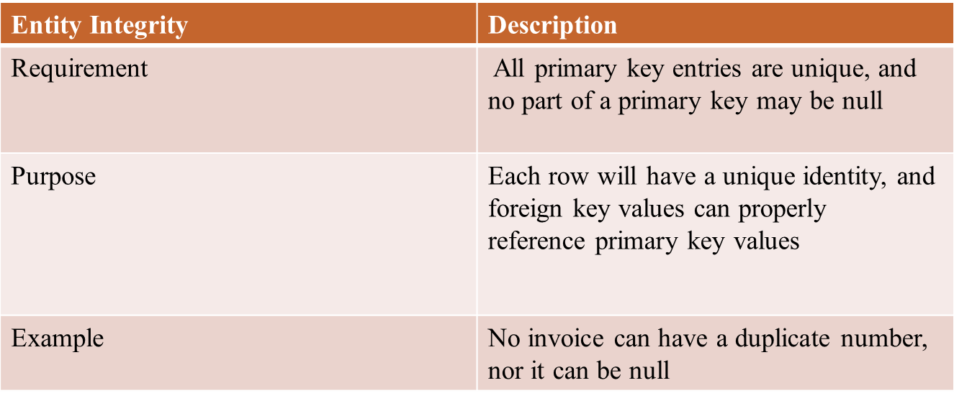
Integrity Rules

Slide 11
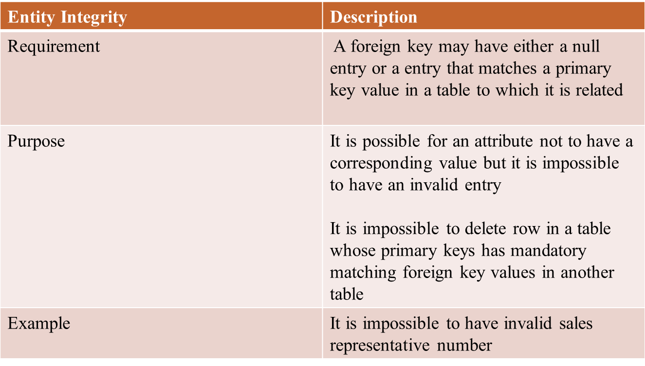
Integrity Rules

Slide 12
Ways to Handle Nulls
Flags: Special codes used to indicate the absence of some value
NOT NULL constraint - Placed on a column to ensure that every row in the table has a value for that column
UNIQUE constraint - Restriction placed on a column to ensure that no duplicate values exist for that column

Slide 13
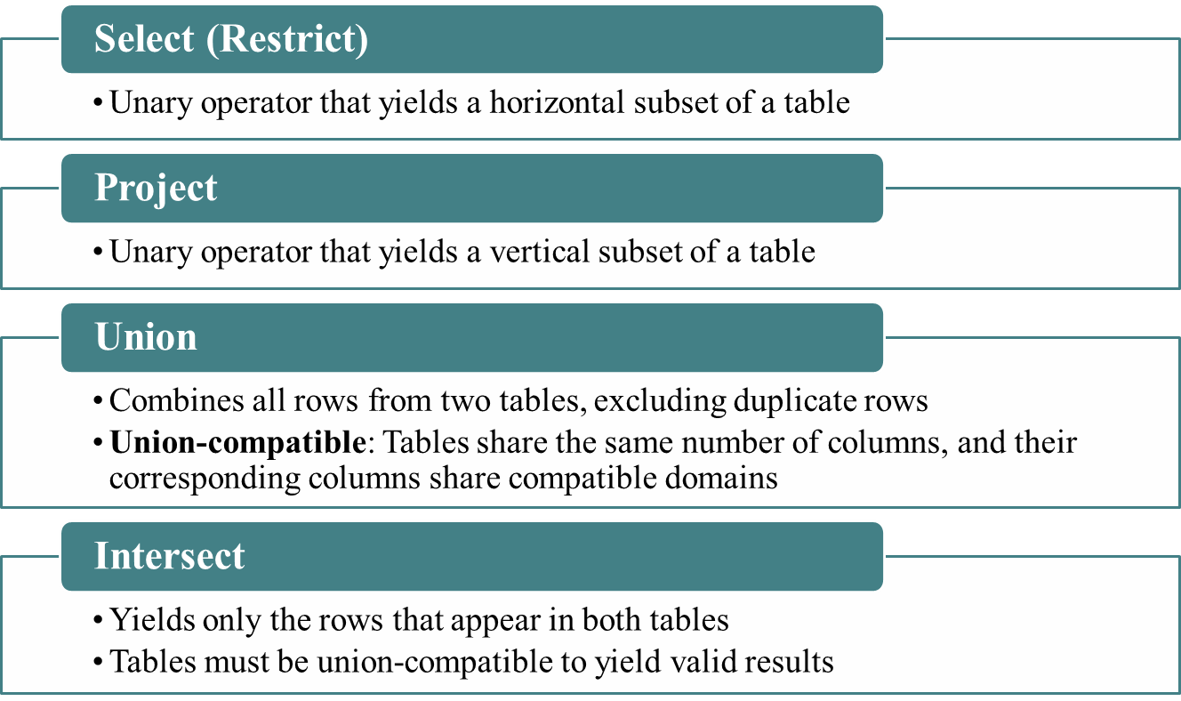
Relational Set Operators

Slide 14
Relational Set Operators
Difference
Yields all rows in one table that are not found in the other table
Tables must be union-compatible to yield valid results
Product
Yields all possible pairs of rows from two tables

Slide 15
Relational Set Operators
Join
Allows information to be intelligently combined from two or more tables
Divide
Uses one 2-column table as the dividend and one single-column table as the divisor
Output is a single column that contains all values from the second column of the dividend that are associated with every row in the divisor

Slide 16
Types of Joins
Natural join: Links tables by selecting only the rows with common values in their common attributes
Join columns: Common columns
Equijoin: Links tables on the basis of an equality condition that compares specified columns of each table

Slide 17
Types of Joins
Inner join: Only returns matched records from the tables that are being joined
Outer join: Matched pairs are retained and unmatched values in the other table are left null
Left outer join: Yields all of the rows in the first table, including those that do not have a matching value in the second table
Right outer join: Yields all of the rows in the second table, including those that do not have matching values in the first table

Slide 18
Data Dictionary and the System Catalog
Data dictionary: Description of all tables in the database created by the user and designer
System catalog: System data dictionary that describes all objects within the database
Homonyms and synonyms must be avoided to lessen confusion
Homonym: Same name is used to label different attributes
Synonym: Different names are used to describe the same attribute

Slide 19
Relationships within the Relational Database
1:M relationship - Norm for relational databases
1:1 relationship - One entity can be related to only one other entity and vice versa
Many-to-many (M:N) relationship - Implemented by creating a new entity in 1:M relationships with the original entities
Composite entity (Bridge or associative entity): Helps avoid problems inherent to M:N relationships, includes the primary keys of tables to be linked

Slide 20
Index
Orderly arrangement to logically access rows in a table
Index key: Index’s reference point that leads to data location identified by the key
Unique index: Index key can have only one pointer value associated with it
Each index is associated with only one table

Slide 21
Data Redundancy
Relational database facilitates control of data redundancies through use of foreign keys
To be controlled except the following circumstances
Data redundancy must be increased to make the database serve crucial information purposes
Exists to preserve the historical accuracy of the data

Slide 22
THANK YOU!

